Slide 1


NCP Math and Implementation
Authors - Mathias Lechner; Ramin Hasani ; Alexander Amini; Thomas Henzinger; Daniela Rus; Radu Grosu
Affiliated Institute - 1 Institute of Science and Technology Austria (IST Austria), Klosterneuburg, Austria
2 Technische Universität Wien (TU Wien), Vienna, Austria
3 Massachusetts Institute of Technology (MIT) CSAIL,Cambridge, USA
Published at - Nature Machine Intelligence
Presented by - Aayush Jannumahanti

Slide 2
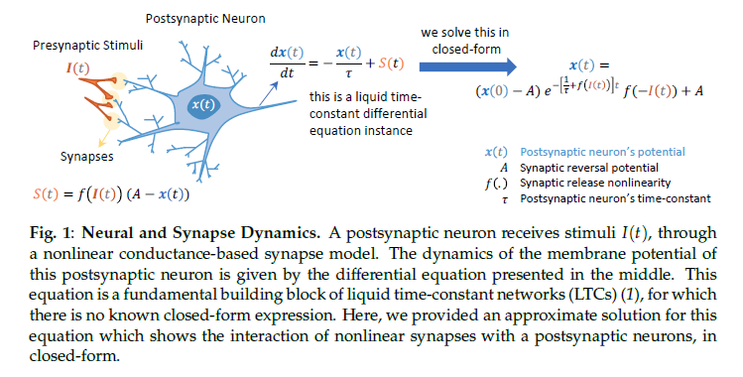
Neural and Synaptic Representation of state dynamic

Slide 3
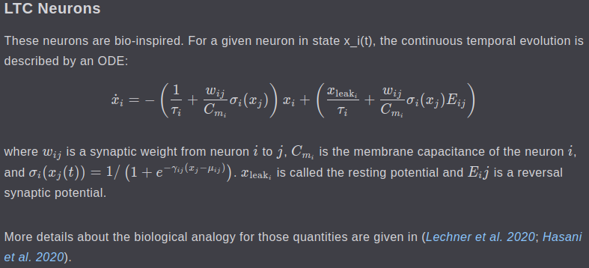
‹#›
Adapting in their Weights ODE (LTC)(ESM)(RC)
ODE Model’s of NCP’s (Here in NCP 19 neurons and 253 synapses exists)
Neural Dynamics of NCP’s are given by continuous time ODE’s
NCPs possess a non linear time varying synaptic time varying mechanism that improve their expressive power in modelling time series data
NCPs Neural Model with State Dynamic Equation is represented by
UMBC VLSI-SOC GROUP

Slide 4

‹#›
LTC neuron coupling sensitivity time constant is represented by -
We employ an ODE Solver to obtain a computational form of the ODE
The Solver is put upon a real time system that puts a hard limit on the worst case executing time, so the solver uses a fixed step size
The ODE Model of an NCP is stiff, to avoid numerical instability, they employ a semi-implicit method
During the training phase, they compute partial derivatives by backpropagating through the solver
Similar to the stability in arguments in forward path, they monitor the error magnitude in the backward phase
A suitable solving method must not result in exploding or vanishing gradient descent problem, To comply with these constraints, they adopt a Euler Approach
As a result for each neuron, they adopt a semi-implicit Euler approach with a fixed step size Δ
Δ represents fixed step size
UMBC VLSI-SOC GROUP

Slide 5

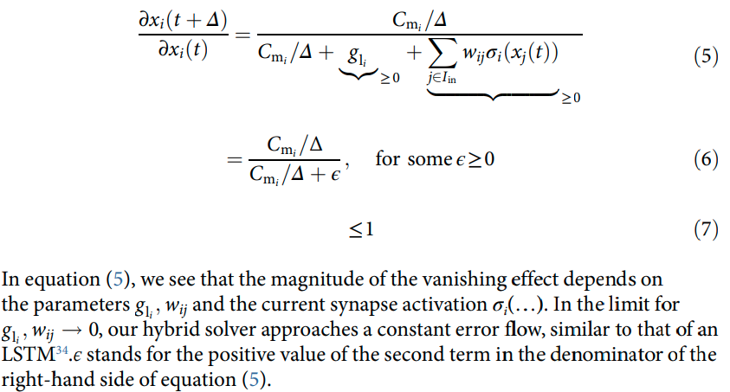
Hybrid ODE
‹#›
Hybrid Solver for ODE
The Iin represents the pesynaptic neuron to i, this equation is derived from the basic euler approach
NCP Expressing Vanishing Gradient Descent Let Xi(t) be the state of an NCP Circuit implementing our hybrid ODE Solver from equation 3
We assume that there is no self-connecting synapse i->i
We obtain
UMBC VLSI-SOC GROUP

Slide 6
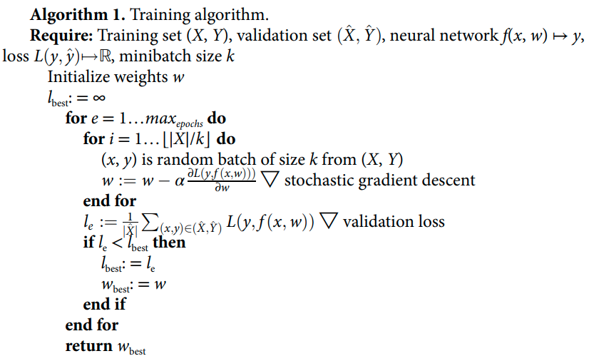
Datasets and Algorithmic Approach
‹#›
Approx 5 hours of driving data through regions of Boston Metropolitan area
Training the Algorithm
UMBC VLSI-SOC GROUP

Slide 7
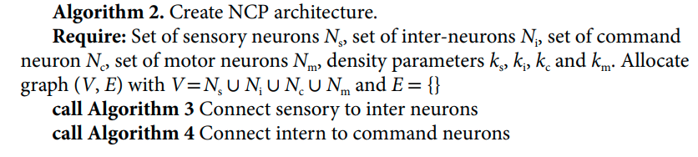
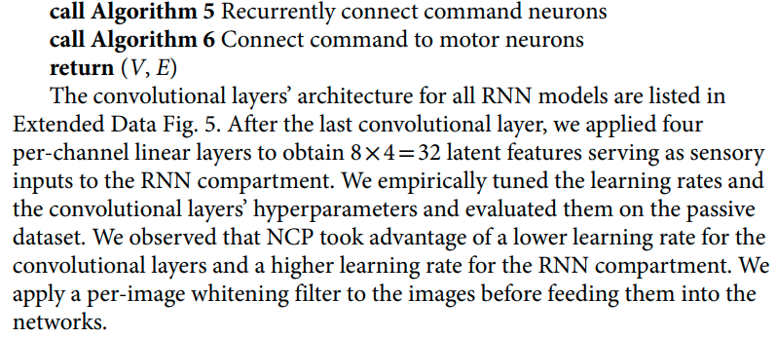
NCP Pseudo Code
‹#›
Creating NCP Architecture
UMBC VLSI-SOC GROUP

Slide 8
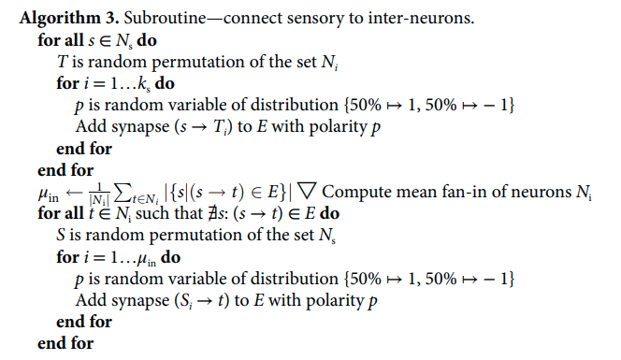
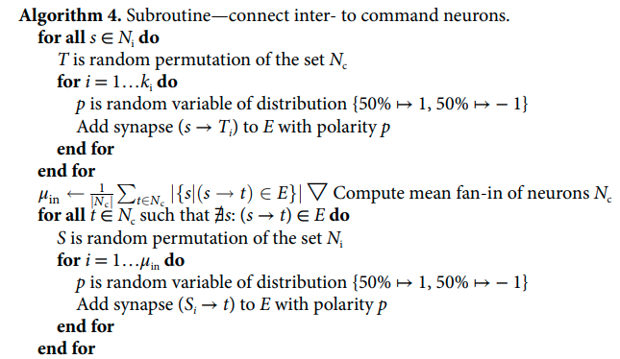
‹#›
NCP Architecture by Procedurally calling connecting subroutines
UMBC VLSI-SOC GROUP

Slide 9
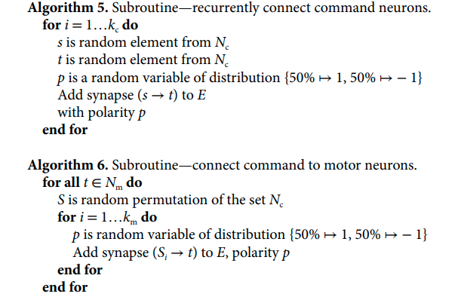
‹#›
UMBC VLSI-SOC GROUP

Slide 10
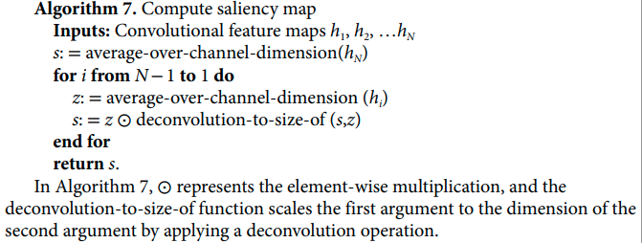
Results and Discussion
‹#›
Saliency Maps are adopted to analyze what the network has learned to attend quantitatively
VisualBackProp has been adopted that is deliberately used for autonomous driving research
This method leverages the property of rectified linear units (ReLu) activation that the value of each neuron in feature map is +ve or 0
UMBC VLSI-SOC GROUP

Slide 11
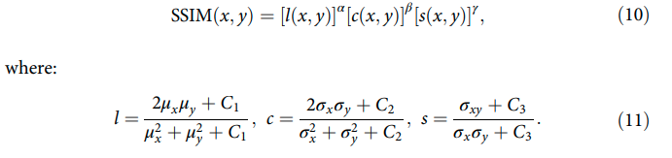
Results and Discussion Con..
‹#›
Structural Similarity Index (SSIM) is a method to compare the quality of the given images, it’s computed based on the luminance (l), contrast (c) and structure (s) for given images of x and y as follows -
Lipschitz continuity computation. The limitation on the speed of change of a function can be computed by the Lipschitz continuity criteria, The lower is the Lipschitz continuity constant the higher is the nonlinearity of the function f
UMBC VLSI-SOC GROUP

Slide 12
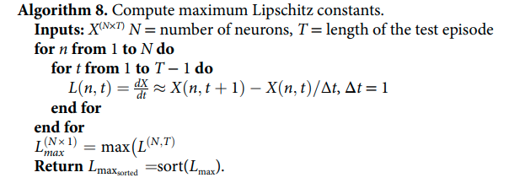
‹#›
Computation of the Lipschitz continuity constant
UMBC VLSI-SOC GROUP

Slide 13
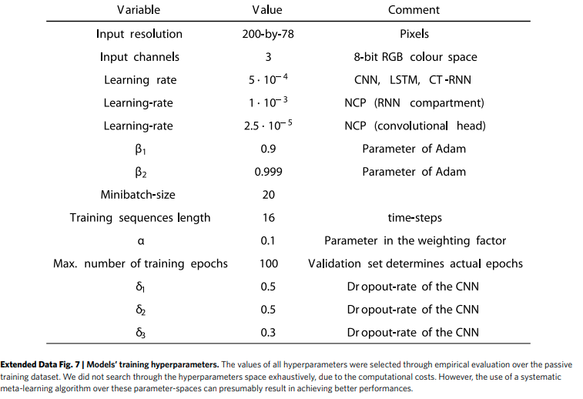
Model Training Hyperparameters
‹#›
UMBC VLSI-SOC GROUP

Slide 14
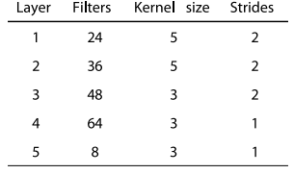
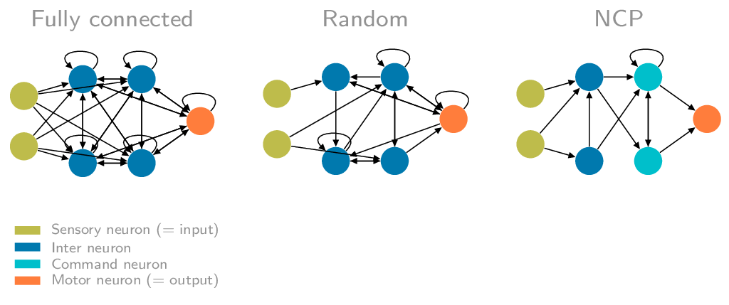
Conclusion and Future Work
‹#›
Size of the convolution kernels
Model overview
UMBC VLSI-SOC GROUP

Slide 15
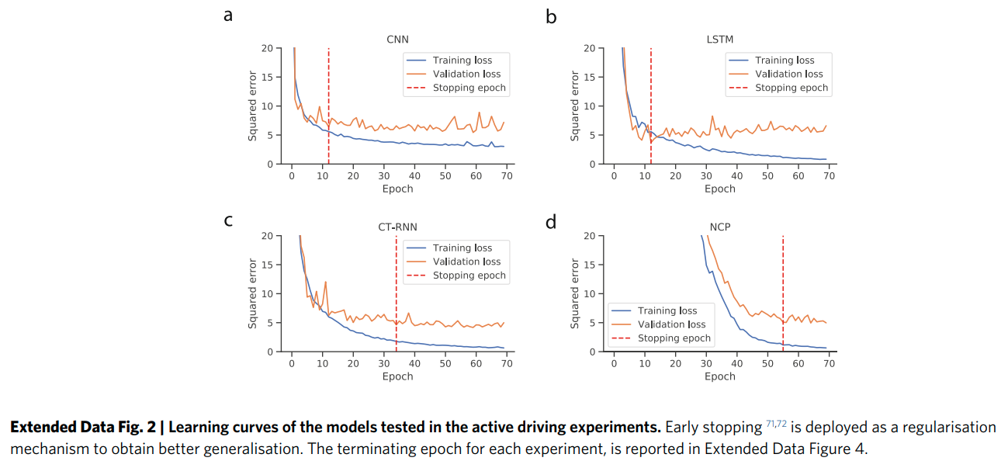
‹#›
Model training during active training environments
UMBC VLSI-SOC GROUP

Slide 16
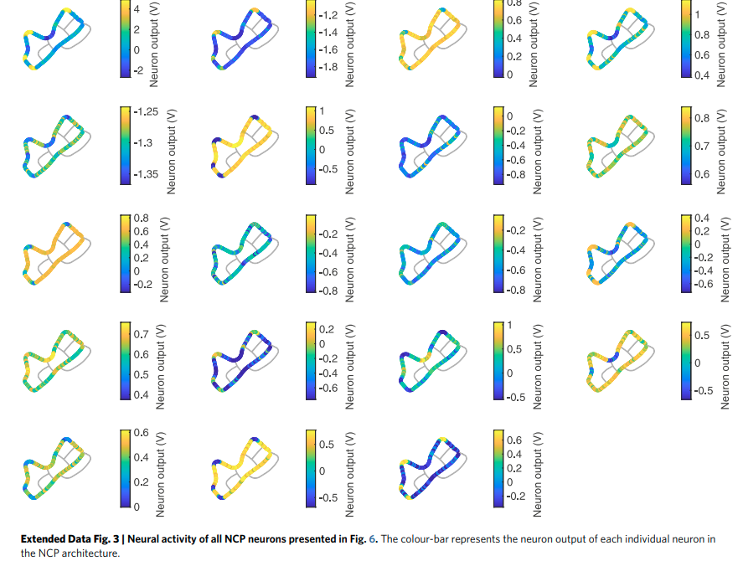
Neural activity of each of the 19 NCP Neurons
‹#›
UMBC VLSI-SOC GROUP

Slide 17
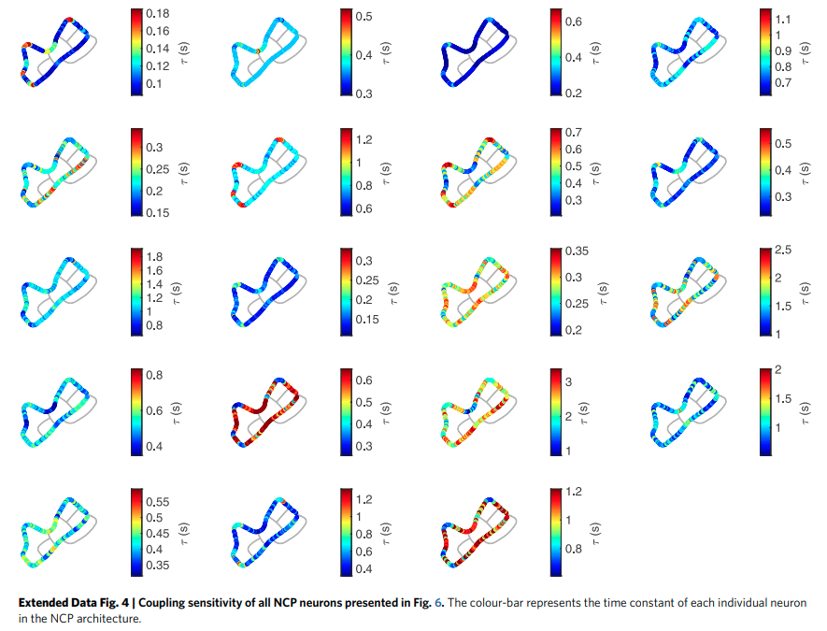
Coupling Sensitivity of all the 19 Neurons
‹#›
UMBC VLSI-SOC GROUP

Slide 18
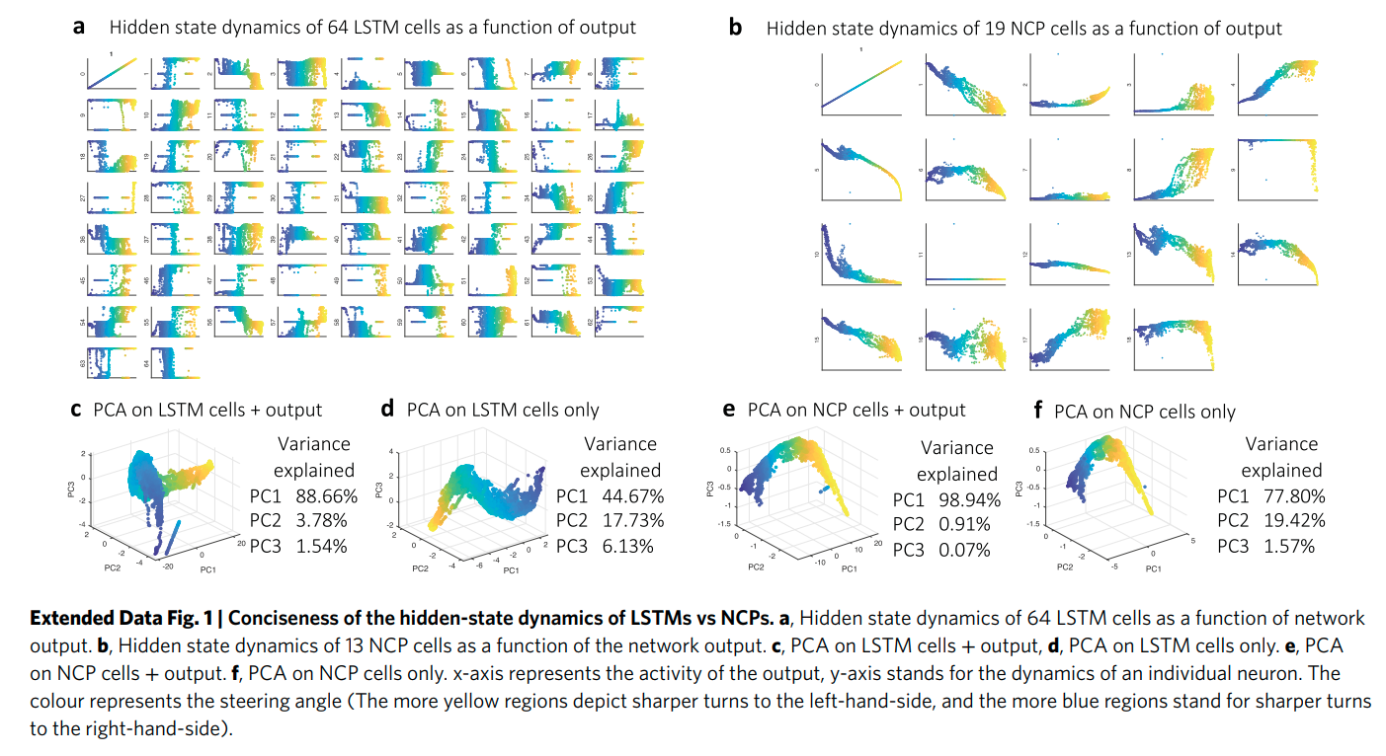
‹#›
Principal Component Analysis of LSTMs vs NCPs
UMBC VLSI-SOC GROUP

Slide 19
Thank you
‹#›
Questions?
UMBC VLSI-SOC GROUP

